Slide 1



AGE 214: Lecture 11
Field Effect Transistors (JFET) Fundamentals
Sokoine University of Agriculture
AGE 214 - Lecture 11

Slide 2




BJT vs FET
BJT
JFET
Current Controlled Device ($I_C$ controlled by $I_B$).
Voltage Controlled Device ($I_D$ controlled by $V_{GS}$).
Bipolar (Electrons & Holes).
Unipolar (Electrons OR Holes).
Low Input Impedance.
Extremely High Input Impedance.
Sokoine University of Agriculture
AGE 214 - Lecture 11

Slide 3

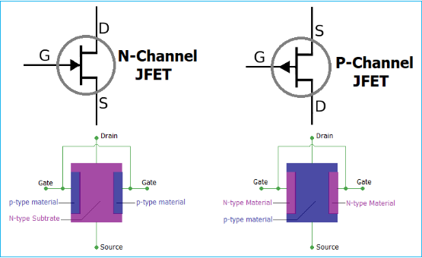
Structure (N-Channel)
Anatomy
•
Channel: A bar of N-type silicon.
•
Gate: Two P-type regions diffused into the side. Connected internally.
•
Source (S): Where electrons enter.
•
Drain (D): Where electrons leave.
Sokoine University of Agriculture
AGE 214 - Lecture 11

Slide 4

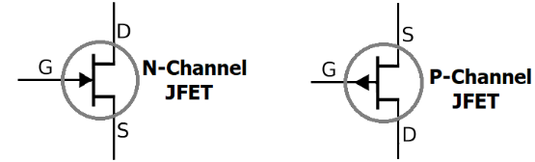
JFET Symbols
Identifying the Type
The arrow indicates the P-N junction polarity (Point to N).
•
N-Channel: Arrow points IN.
•
P-Channel: Arrow points OUT.
Note: The Gate current ($I_G$) is effectively Zero.
Sokoine University of Agriculture
AGE 214 - Lecture 11

Slide 5
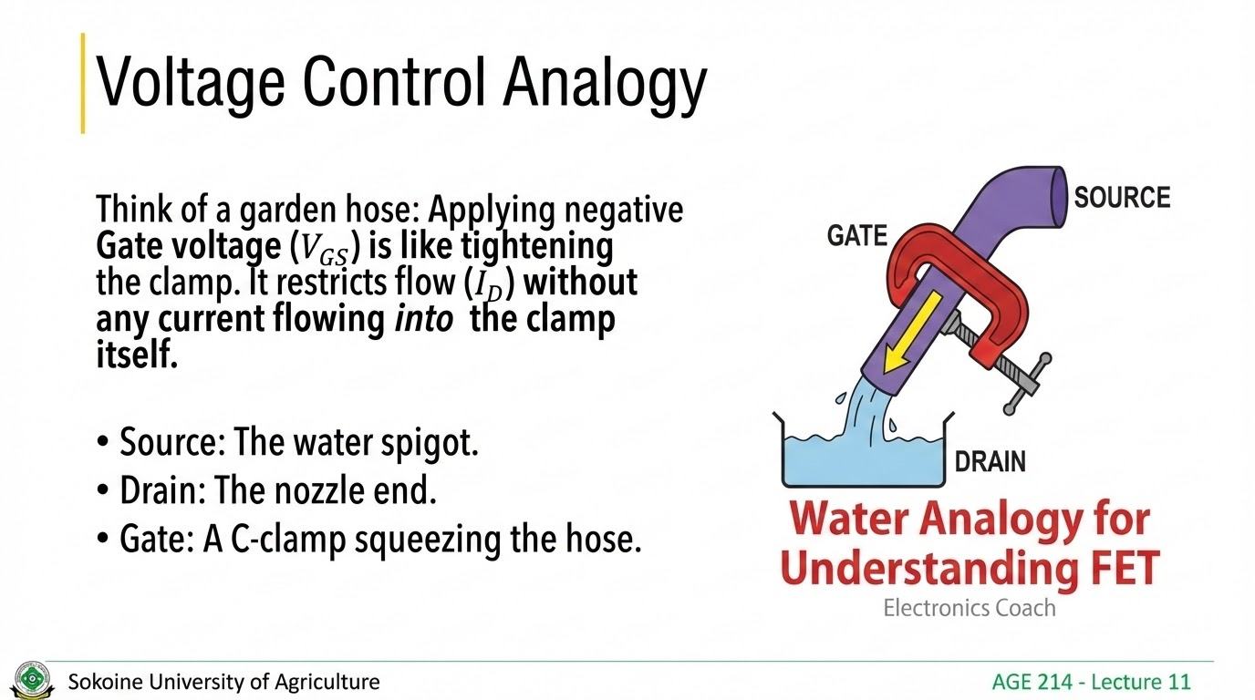

Slide 6
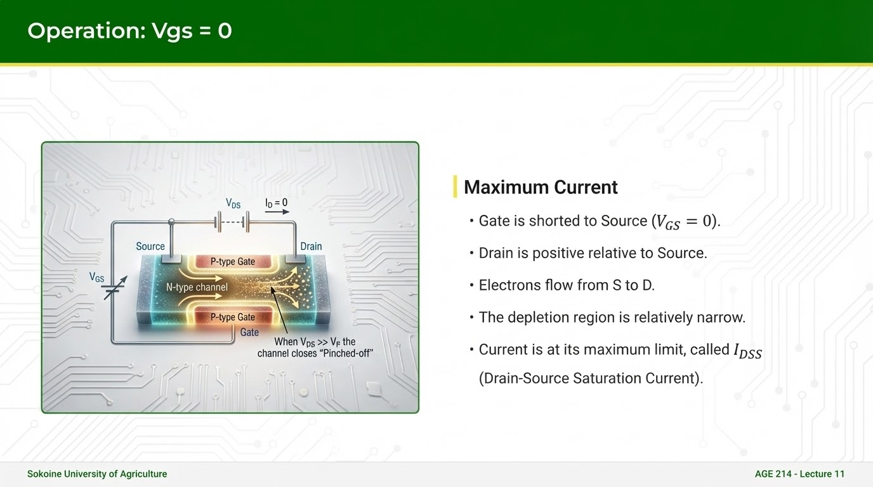

Slide 7
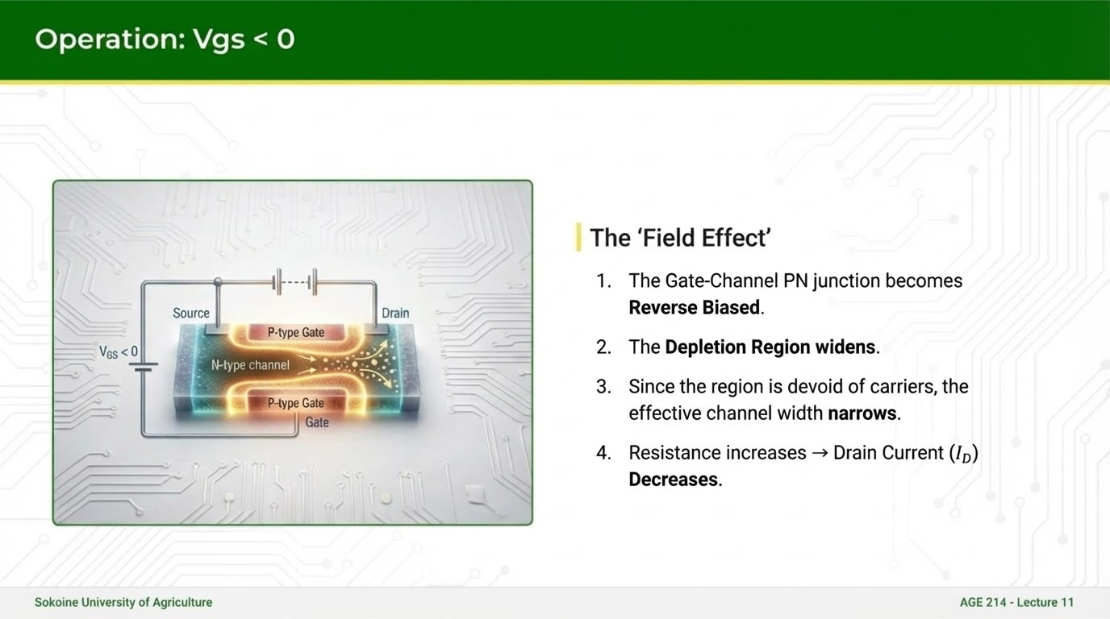

Slide 8
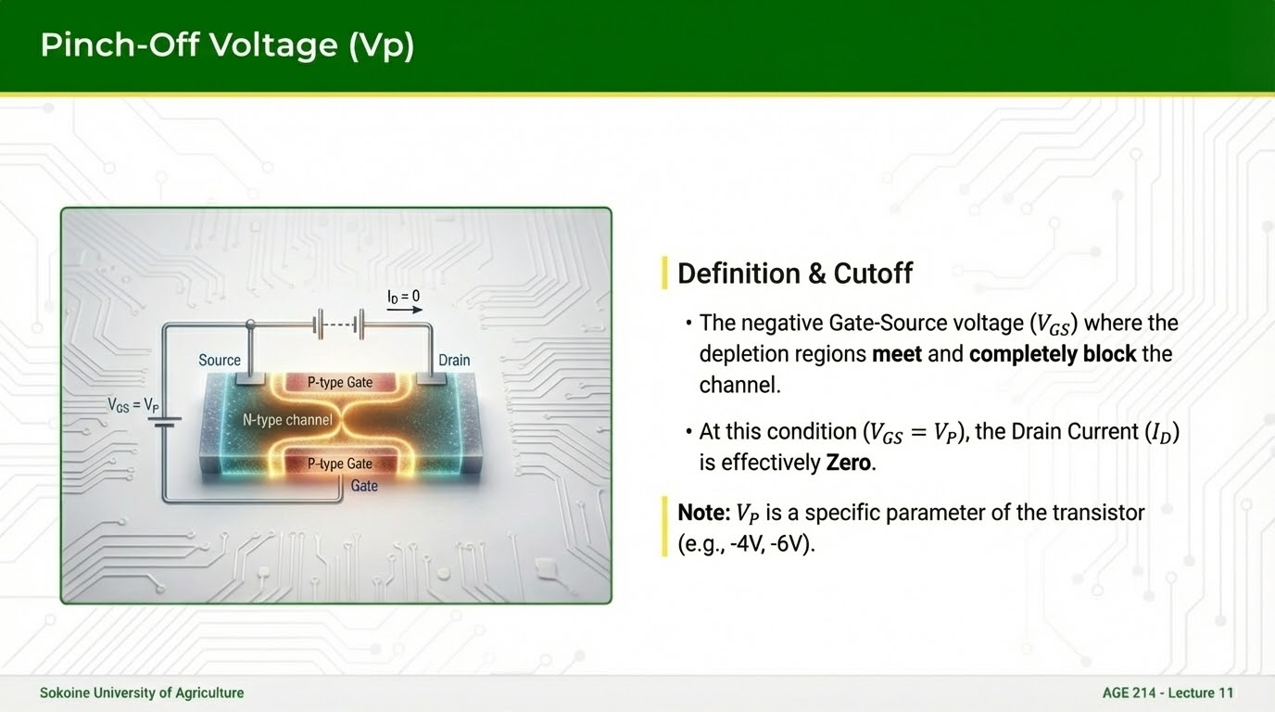

Slide 9
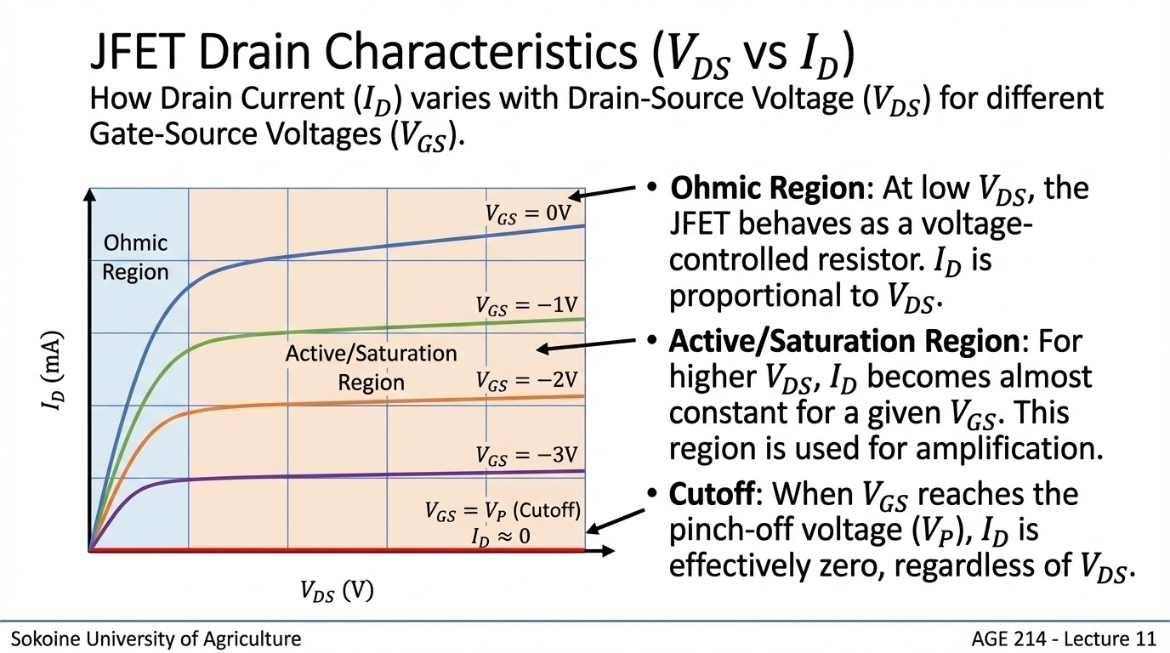

Slide 10
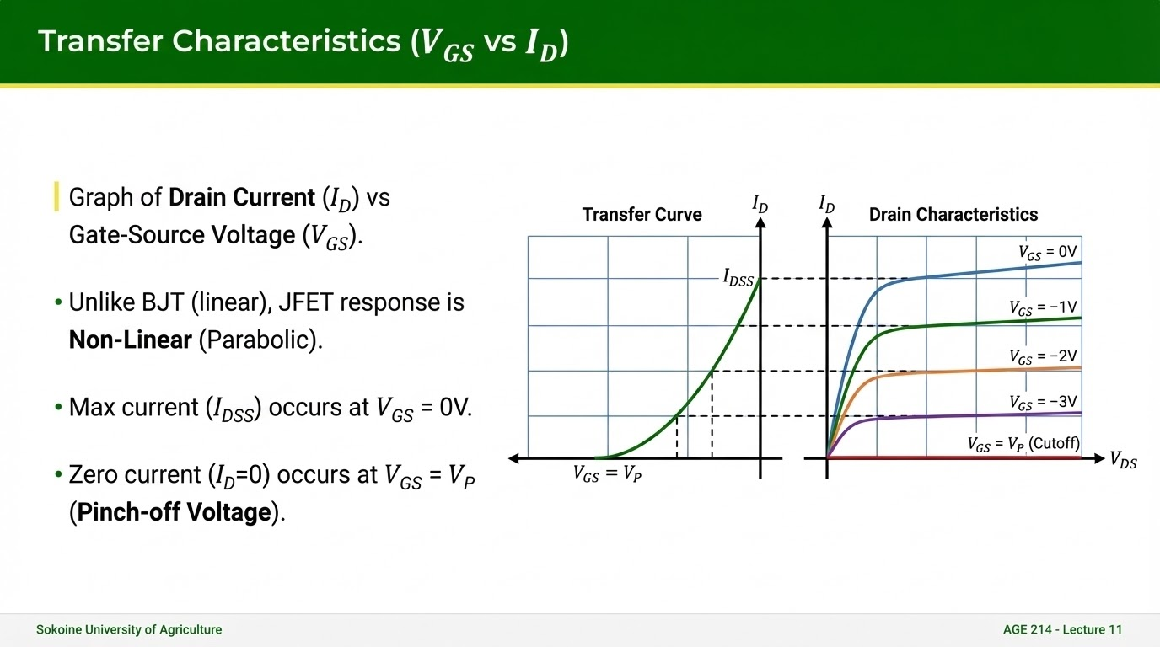

Slide 11

Mathematical Model
Shockley's Equation
Describes the parabolic transfer curve:
ID: Drain Current
IDSS: Saturation Current (Max)
VGS: Gate-Source Voltage
VP: Pinch-off Voltage
Sokoine University of Agriculture
AGE 214 - Lecture 11

Slide 12
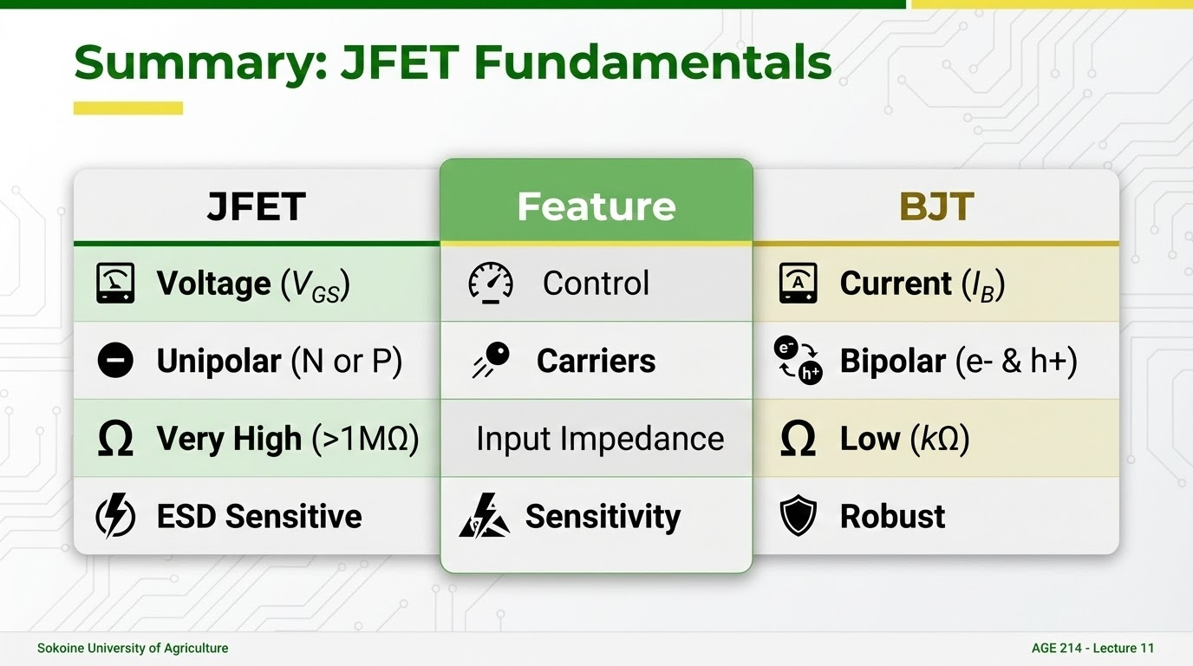

Slide 13
Questions?
Next Lecture: MOSFETs
Dr. Kadeghe Fue
Sokoine University of Agriculture
AGE 214 - Lecture 11

Slide 14





Image Sources
https://circuitdigest.com/sites/default/files/projectimage_tut/JFET-Construction-Working-and-Biasing.png
Source: circuitdigest.com
https://www.allelcoelec.com/upfile/images/18/20240820092845761.png
Source: www.allelcoelec.com
https://electronicscoach.com/wp-content/uploads/2018/03/Water-analogy.jpg
Source: electronicscoach.com
https://www.electronics-tutorials.ws/wp-content/uploads/2018/05/transistor-tran16a.gif
Source: www.electronics-tutorials.ws
https://i.ytimg.com/vi/h9WlHNVHZ84/sddefault.jpg
Source: www.youtube.com

